Slide 1
mNGS
metagenomic Next-Generation Sequencing
Rapid Response – Updated Feb 2026

Slide 2
Key points to learn in this session
What is mNGS and why is it useful?
Terminology and types of sequencing
Use cases
Other genomics tools in infectious diseases
Sequencing technologies
Notes:
Context in the are of ID

Slide 3

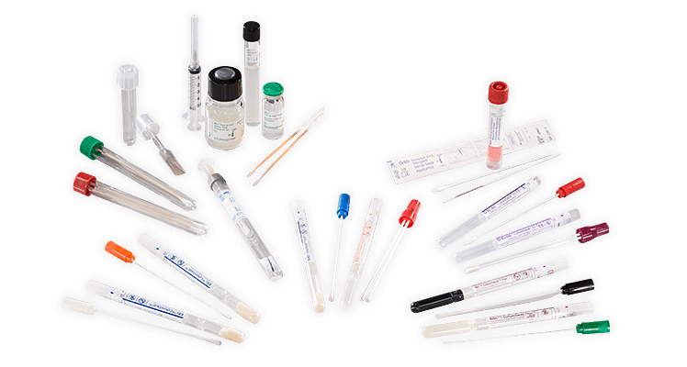



Introduction
Pathogen landscape
Sample landscape
NGS toolbox for infectious diseases

Slide 4

Slide courtesy of Joe DeRisi
Notes:
diversity

Slide 5
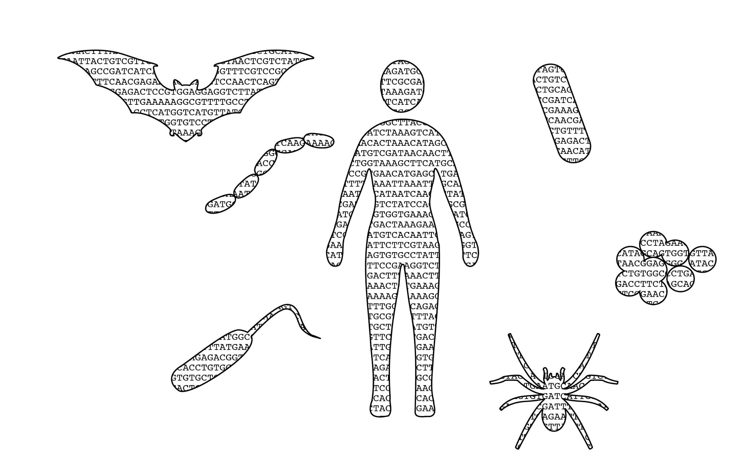
Slide courtesy of Joe DeRisi
Notes:
All in common

Slide 6



mNGS
Metagenomic next-generation sequencing (mNGS) is the
comprehensive analysis of all of the genetic material present in a sample
Why is it useful?
Because it is an unbiased approach to detecting and measuring nucleic acids, unlike other methods…
Notes:
Unbiased, agnostic, everything

Slide 7

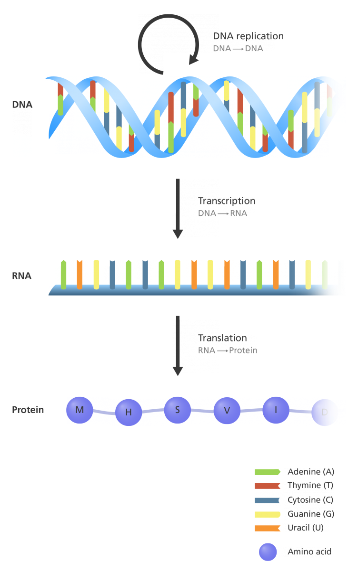

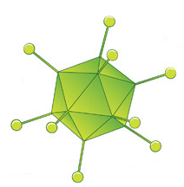

Organisms vary widely in their genetic makeup
DNA replication by DNA polymerases
DNA → DNA
 | Viruses | Bacteria | Eukaryotic microbes (yeast, amoebas, worms, etc)
Genome composition | ssRNA, ssDNA, dsDNA, or dsRNA | dsDNA | dsDNA
Ribosomal RNA | None, uses host ribosomes | 16S rRNA | 18S rRNA
Genome size | 2 Kb - 1 Mb | 2 Mb - 8 Mb | 200 Kb - 100,000 Mb
Transcription by RNA polymerases
DNA → RNA
Translation by ribosomes
RNA → Protein
Adapted from yourgenome.org

Slide 8

Sample type landscape
Nasal or oral swab
50% microbial (mostly bacteria)
Different sample types have different RNA contents!
Cerebral Spinal Fluid
No infection: 0% microbial
With infection: <1% - 5%
Whole Blood: lot of background
No infection:
During infection: <<<0% microbial
Tracheal Aspirate
5% microbial, 95% human
Serum or Plasma
10-100x less host material
Host
Microbial
Rectal or Vaginal swabs or stool
50% microbial (mostly bacteria)

Slide 9

Different sample types have different microbial nucleic acid content!
Whole animal/vector:
98% host
1.99% normal flora
0.01% vector borne pathogen
Environmental samples:
High content: wastewater
Low content: aerosol samples, swabs
Human samples:
High content: stool, rectal swab
Low content: plasma, CSF
Notes:
Make sure it is clear that it is microbial content that is being referred to!

Slide 10
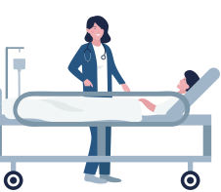




Use cases for mNGS
Identify a novel pathogen
Outbreak detection and prevention
Identify coinfections
Characterize the microbial landscape
+

Slide 11
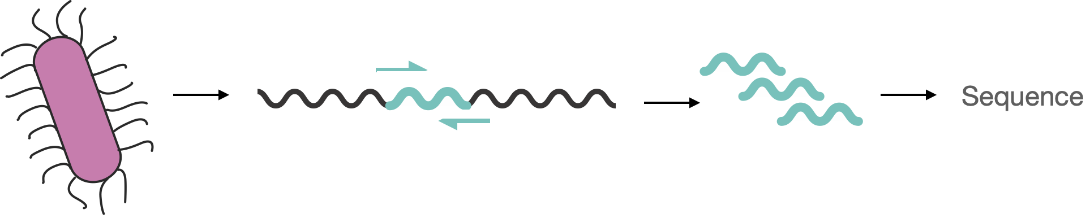
Genomics tools in infectious diseases
sequencing fragments with Sanger sequencing
WGS
Amplicon sequencing
16S sequencing
Metagenomics NGS
Single sample
PCR enrichment of a single target
Sanger Sequence
(low throughput)

Slide 12
Sanger sequencing
Input | One enriched DNA template from a single sample Primers complementary to the ends of the DNA target template
Output | Sequence of one fragment ~500-600bp or one PCR product or plasmid
Strengths | Fast and cheap High accuracy
Uses | Screen for a variant(s) in a specific known genomic region Often used to confirm cloning products/plasmids Confirm NGS findings
Limitations | Short sequence lengths Low throughput One sample at a time One region/target at a time | Requires large amount of DNA input Requires knowledge of the target

Slide 13
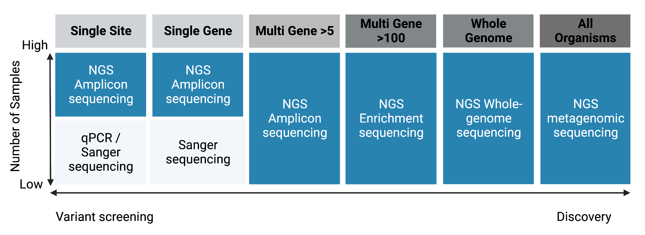
Sanger sequencing vs Next Generation Sequencing applications
Adapted using BioRender.com from https://www.illumina.com/science/technology/next-generation-sequencing/ngs-vs-sanger-sequencing.html

Slide 14
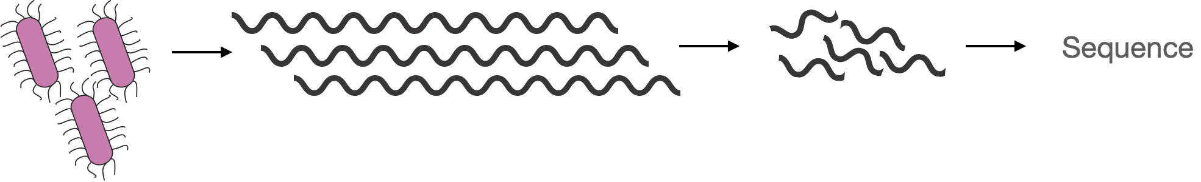
Whole genome sequencing
Sanger sequencing
WGS
Amplicon sequencing
16S sequencing
Metagenomics NGS
High molecular weight DNA
Fragmentation
(short-read platforms)
Single organism

Slide 15
Whole genome sequencing
Input | High molecular weight DNA from a cultured isolate
Output | NGS sequencing of the genome of the cultured organism
Strengths | Does not require specific primer design Good genome coverage of organisms even with large genomes
Uses | Obtain whole genome coverage of organisms even with large genomes Identify or confirm identity of a cultured organism Identify genomic variants within an organism
Limitations | Requires a cultured isolate Time-intensive Not all organisms can be cultured; many require special conditions | More hands-on time due to culture requirement

Slide 16

Amplicon sequencing
Sanger sequencing
WGS
Amplicon sequencing
16S sequencing
Metagenomics NGS
Complex sample
Multiplex PCR enrichment of a multiple targets
(in this case, tiled PCR enrichment of a whole genome of a single organism)

Slide 17
Amplicon sequencing
Sanger sequencing
WGS
Amplicon sequencing
16S sequencing
Metagenomics NGS
Complex sample
Multiplex PCR enrichment of a multiple targets
(in this case, tiled PCR enrichment of a whole genome of a single organism)
WGS
Amplicon sequencing

Slide 18
Amplicon sequencing
Input | Direct clinical sample or other sample type; does not require a cultured isolate Primers complementary to the target regions / organism of interest
Output | NGS sequence of many PCR products in parallel; genome of organism of interest
Strengths | Good coverage of whole genome of relatively small genomes Does not require a culture isolate; can be a mixed/direct sample The majority of resulting data is of the desired target
Uses | Genomic epidemiology Transmission investigation | Identification or monitoring of variants
Limitations | Requires good primer design and validation Requires knowledge of the target Can be difficult for large genomes | Not robust to mutations in primer binding sites

Slide 19
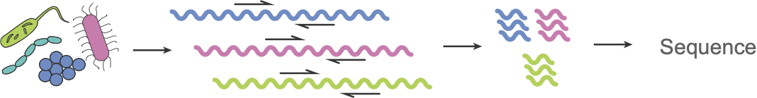
16s sequencing
Sanger sequencing
WGS
Amplicon sequencing
16S sequencing
Metagenomics NGS
Complex sample
PCR enrichment of ribosomal gene target (16s)
(this gene is conserved across bacterial species)

Slide 20
16s sequencing
Sanger sequencing
WGS
Amplicon sequencing
16S sequencing
Metagenomics NGS
Amplicon sequencing
WGS
16s sequencing
Complex sample
PCR enrichment of ribosomal gene target (16s)
(this gene is conserved across bacterial species)

Slide 21
16s sequencing
Input | Direct clinical sample or other sample type; does not require a cultured isolate Primers complementary to the 16s rRNA gene (V1, V2, or V3 regions)
Output | NGS sequences of amplified 16s rRNA gene target for all but only bacteria in the sample
Strengths | Good sensitivity in picking up low abundance targets Does not require a culture isolate; can be a mixed/direct sample The majority of resulting data is of the desired target
Uses | Microbiome studies Phylogeny and taxonomic classification
Limitations | Can only detect bacteria (organisms that carry 16s rRNA gene) Can be hard to resolve closely related species | Does not detect antibiotic resistance genes or targets

Slide 22
Metagenomic sequencing
Sanger sequencing
WGS
Amplicon sequencing
16S sequencing
Metagenomics NGS
High molecular weight DNA (ideally)
Fragmentation
(short-read platforms)
Complex sample
(if low input, non-targeted amplification will be necessary)

Slide 23
Metagenomic sequencing
Input | Direct clinical sample or other sample type; does not require a cultured isolate
Output | NGS sequence of all organisms in each sample
Strengths | Does not require a culture isolate; can be a mixed/direct sample Unbiased recovery of nucleic acids in a mixed sample Does not require specific primer design
Uses | Identification of pathogens with unknown origin Identification of coinfections Screening surveillance for multiple organisms with one assay Outbreak investigation Pathogen discovery work
Limitations | Occasionally very low abundance microbes can be missed Data analysis and interpretation can be difficult The host is sequenced along with the microbes; can be difficult to remove

Slide 24
Genomics sequencing toolbox for infectious diseases
 | Whole genome & transcriptome sequencing | Amplicon sequencing | 16S & 18S rRNA sequencing | Metagenomic (shotgun) sequencing
Starting material | DNA/RNA from (cultured) isolate | DNA/RNA from a sample | DNA/RNA from a sample | DNA/RNA from a sample
Primers used to amplify sequences | Random primers | Organism-specific primers | 16S/18S-specific primers | Random primers
What is sequenced? | Organism of interest | Organism of interest | Only rRNA from bacteria, fungi and eukaryotic pathogens in sample | DNA/RNA from all organisms in sample
Resulting data | DNA sequence or gene expression of target organism | RNA/DNA sequence of targeted organism | Only rRNA sequences of bacteria, fungi and eukaryotic pathogens | DNA/RNA sequences from all organisms in sample
Use cases | Fundamental research on cultured organisms | Full genomes from clinical samples for genomic epidemiology | Exploratory studies on environmental samples | Outbreak research, co-infections, microbe discovery

Slide 25
Sequencing technologies

Slide 26
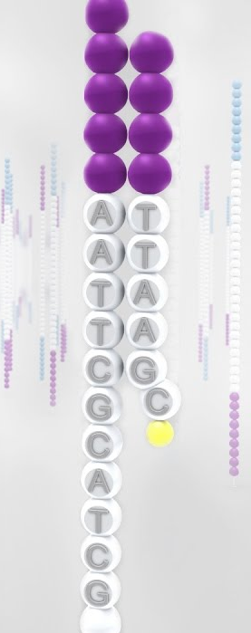
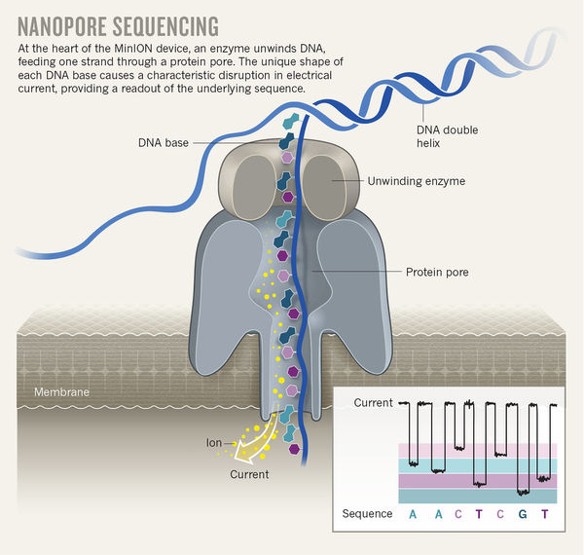
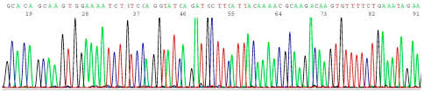
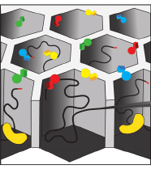
Low throughput, short read sequencing
High throughput, short read sequencing
Long read sequencing
Nanopore Sequencing
Illumina sequencing
Sanger sequencing
Thousands to millions of 1-20kb
sequences
1 x 500bp sequence per well
PacBio sequencing
Thousands of
1 - 30kb
sequences
Millions of 300-600bp sequences

Slide 27

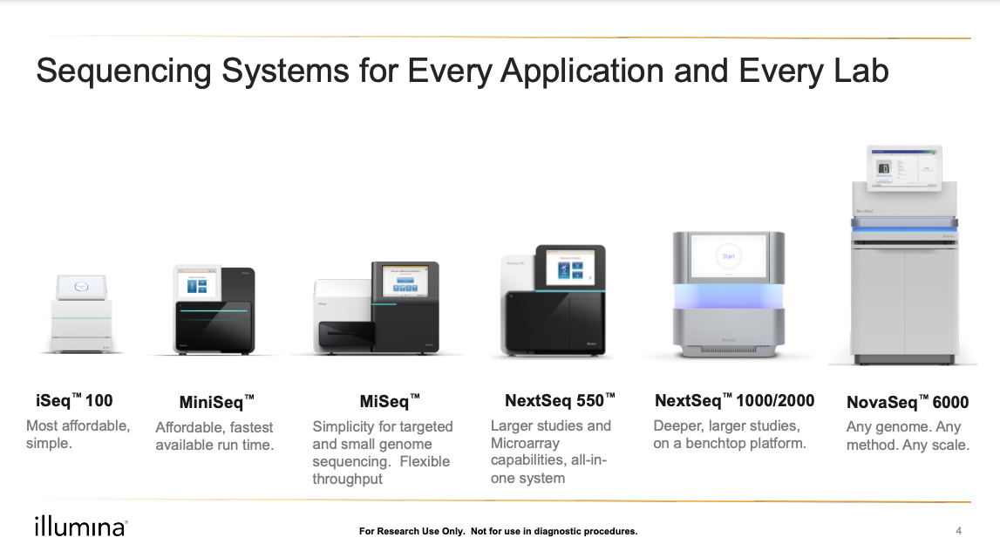
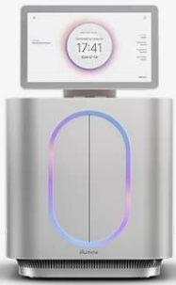
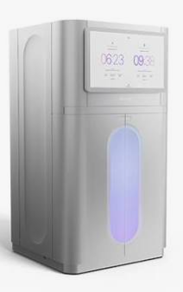
XLEAP-SBS (improved chemistry)
MiSeq i100 (Plus option)
5-200 million reads
High thruput short read sequencing max. read length 300bp
NextSeq 1000/2000
100 million to 3.6 billion reads
Cheapest instruments
Low thruput
EOL in 2025
Supported ~2029
High thruput
Still supported
Phased out
NovaSeqX (Plus option
1.6 – 70 billion reads
Notes:
HT sequencing lowers costs and

Slide 28

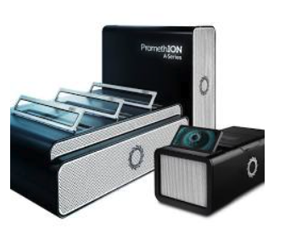
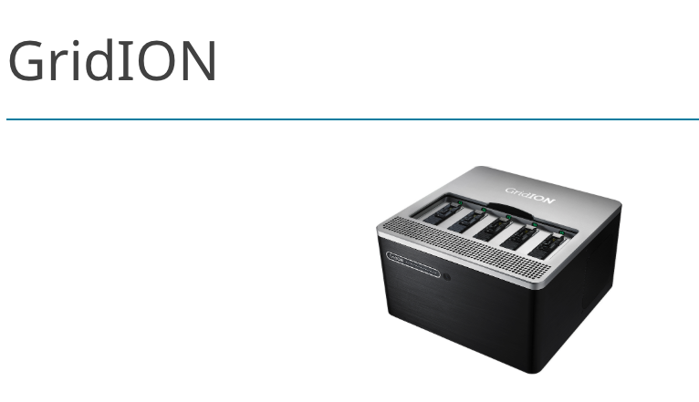

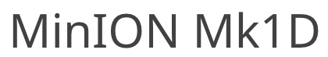
High thruput long read sequencing
PromethION Series
Instruments that will sequence from 1 to 48 flow cells.
The MinION instruments require an external computer
Notes:
HT sequencing lowers costs and

Slide 29



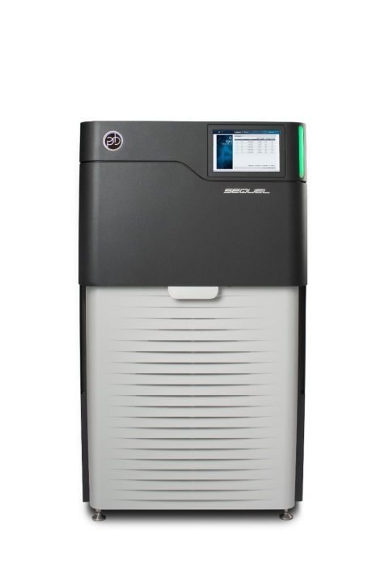

Other sequencing platforms
Long read
Short read

Slide 30
Comparing short and long read sequencing platforms
Feature | Short-Read Sequencing (e.g. Illumina) | Long-Read Sequencing (e.g. Oxford Nanopore)
Read Length | 50-300 bp | 100 bp - 100,000 bp
Accuracy | High (99.9% with Illumina) | Lower (~90-99%) but improving
Cost per run | ~$800 | ~$900
Instrument Cost | ~$20,000 | ~$3,000
Throughput (claimed) | 1.2 Gb | 20 Gb
Throughput (observed) | 1.2 to 2 Gb | 1-6 Gb
Run Time | Hours to days | Minutes to days (potentially real-time)

Slide 31
Considerations for choosing a sequencer platform
Available resources
  Procurement
  Lead time
  Frequency of use
  Expertise and comfort
  Downstream integration
  Support
Objective
  Identification
  Variant quality in complex genomes
  Turnaround time
Sample
  Input
  Quality

Slide 32






mNGS pipeline
Study design
xNA extraction
Library prep
Sequencing
Data analysis
Pathogen ID
(1-2 hrs)
(1-2 days)
(0.5-3 days)
(0.5-4 hrs)
Type(s)
Controls
Storage
Lab setup
Type(s)
Controls
QC
Host removal
Fragmentation
dsDNA generation
End-repair
Adapter ligation
Barcoding & PCR
Clean-up
Pooling
QC
Machine
Read length
Loading conc.
QC data
Host removal
Alignment
Blast
Ranking of hits

Slide 33
Next: 02_mNGS study design

